Slide 1
INFINITY YOGA TUTOR YOGA POSTURE DETECTION AND CORRECTION SYSTEM

Slide 2
INTRODUCTION
In today's world, people are occupied with their schedules of hectic work. Due to those busy time schedules, most of the people are facing many health issues. According to the University of Rochester Medical Centre [1], top ten medical issues are physical activity and nutrition, overweight and obesity, tobacco substance abuse, HIV/AIDS, mental health, injury and violence, environmental quality, immunization and access to health care.

Slide 3
MOTIVATION
When you're stronger and more flexible, your posture improves. Most standing and sitting poses develop core strength, since you need your core muscles to support and maintain each pose. With a stronger core, you're more likely to sit and stand "tall." Yoga also helps your body awareness.

Slide 4
OBJECTIVE
To improve strength, balance and flexibility.
To enable the student to have good health.
To practice mental hygiene.
To possess emotional stability.

Slide 5
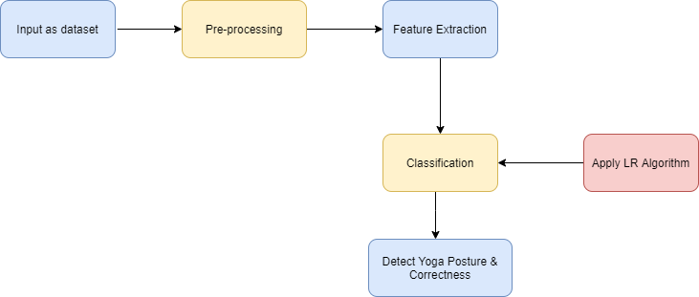
SYSTEM ARCHITECTURE

Slide 6
LITERATURE SURVEY
PROJECT NAME :-Simulation of Optically Injection-Locked Microwave Oscillators Using a Novel SPICE Model
ABSTRACT :-Optical injection locking of GaAs FET microwave oscillators has been examined experimentally as well as by using two different optical interaction models. A novel first-order interaction model which utilizes a standard version of SPICE has been developed which produces predictions of injection locking range in excellent agreement with measured results.
KEYWORDS :- Machine learning, Artificial learning, CNN and Image processing.

Slide 7
PROJECT NAME :-Novel IoT-Based Privacy-Preserving Yoga Posture Recognition System Using Low-Resolution Infrared Sensors and Deep Learning
ABSTRACT :- In recent years, the number of yoga practitioners has been drastically increased and there are more men and older people practice yoga than ever before. IoT-based yoga training system is needed for those who want to practice yoga at home. Some studies have proposed RGB/Kinect camera-based or wearable device-based yoga posture recognition methods with a high accuracy; however, the former has a privacy issue and the latter is impractical in the long-term application.
KEYWORDS :- Machine learning, Artificial learning, CNN and Image processing.

Slide 8
PROJECT NAME :-Yoga Posture Recognition By Detecting Human Joint Points In Real Time Using Microsoft Kinect
ABSTRACT :-Musculoskeletal disorder is increasing in humans due to accidents or aging which is a great concern for future world. Physical exercises can reduce this disorder. Yoga is a great medium of physical exercise. For doing yoga a trainer is important who can monitor the perfectness of different yoga poses.
KEYWORDS :- Machine learning, Artificial learning, CNN and Image processing.

Slide 9
MATHEMATICAL MODEL
Let S be the Whole system S= {I,P,O}
I-input
P-procedure
O-output
Input( I)
I={ Image dataset}
Where,
Dataset-> Image
Procedure (P),
P={I, Using I System perform operations and calculate the prediction }
Output(O)-
O={System detect the yoga pose}

Slide 10
SOFTWARE & HARDWARE REQUIREMENTS
Software Requirements:
Operating system :- Windows 10.
Coding Language :- Python
IDE :- Spyder
Database :- SQLite
Hardware Requirements:
System :- Intel I5 Processor.
Hard Disk :- 40 GB.
Monitor :- 15.
Ram :- 8 GB

Slide 11
CONCLUSION
In order to support a healthy lifestyle for the community of yoga practitioners, we have proposed a system which is able to guide them to practice yoga more accurately in real time. This proposed system is capable of identifying yoga postures using an android mobile. When the user practices yoga, a live mobile feed is streamed to the server which has multiple modules interconnected to predict and output the asana and the accuracy. A video guide of the predicted pose is shown to the user in real time helping the user reach the stance properly.

Slide 12
REFERENCES
M. Gochoo et al, "Novel IoT-Based Privacy-Preserving Yoga Posture Recognition System Using Low-Resolution Infrared Sensors and Deep Learning," in IEEE Internet of Things Journal, vol. 6, no. 4, pp. 7192- 7200, Aug. 2019.
M. U. Islam, H. Mahmud, F. B. Ashraf, I. Hossain and M. K. Hasan, "Yoga posture recognition by detecting human joint points in real time using microsoft kinect," 2017 IEEE Region 10 Humanitarian Technology Conference (R10-HTC), Dhaka, 2017, pp. 668-673.
P.K. Borkar, M.M. Pulinthitha, A. Pansare, 2019, "Match Pose - A System for Comparing Poses," International Journal of Engineering Research and Technology(IJERT), vol. 08, issue 10, Oct 2019.
M. C. Thar, K. Z. N. Winn, N. Funabiki, "A Proposal of Yoga Pose Assessment Method Using Pose Detection for Self-Learning, 2019 International Conference on Advanced Information Technologies (ICAIT), Yangon, Myanmar, 2019, pp. 137-142

